Slide 1
Know the Ropes When Flagging Your Vessel
Panelists: Stephanie Penninger, Esq.,
Benesch, Friedlander, Coplan & Aronoff LLP
Bonnie Huen, Esq.
Isaacs and Co.
Carrol Hand, Esq.
International Registries, Inc.
Moderator: Sarah Yantakosol Gayer, Esq.,
Thompson & Bowie, LLP

Slide 2
Overview
Considerations when Registering a Vessel
A Comparison of the Worlds Du Jour Vessel Registries:
  International Treatment
  Registration Qualifications
  Registration Fees
  Taxation
  Mortgages and Maritime Liens
  Manning and Safety Requirements
  Labor and Operating Costs

Slide 3
Introduction
United National Convention on the Law of the Sea (UNCLOS), Article 91:
  “Every State shall fix the conditions for the grant of its nationality to ships, for the registration of ships in its territory, and for the right to fly its flag. Ships have the nationality of the State whose flag they are entitled to fly.”
Types of flags and distinguishing characteristics
  Traditional
  Open
  Hybrid

Slide 4
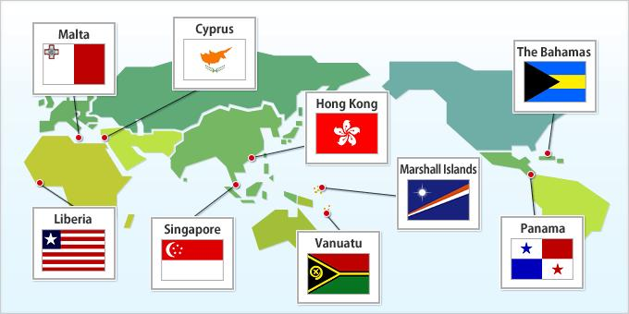
Taking the Right Tack
International Treatment

Slide 5
International Treatment – United States
U.S. is a signatory of the four “pillars” of international maritime law:
  SOLAS;
  STCW Convention;
  MARPOL; and
  MLC 2006.
Listed in the first edition of the “White List”
Not a member of any Port State Control Memorandum of Understanding (MOU)
U.S. flagged vessels are at an economic disadvantage against countries lacking safeguards, such as the Seaman’s Act

Slide 6
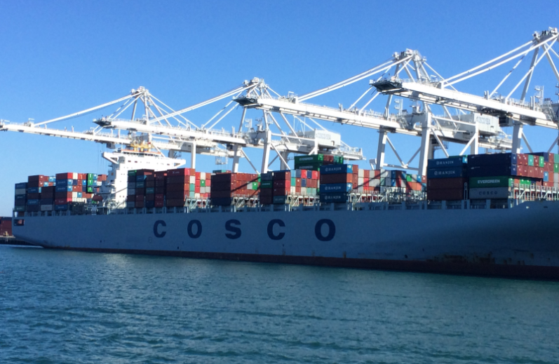
International Treatment - Canada
Signatory to Tokyo Memorandum of Understanding
Not on black list or white list, since there were fewer than 30 inspections from 2012-2014 (low volume)
  0 detentions out of 1 inspection

Slide 7
International Treatment – RMI
Introduction to the Republic of Marshall Islands (“RMI”) flag
Highest international ratings
  White lists for Paris and Tokyo Memorandums of Understanding
  11 consecutive years on U.S. Coast Guard’s Qualship 21 List
  Meets flag criteria for a low risk ship under the Paris MoU’s New Inspection Regime
International Representation
  IMO and ILO
Signatory to and enforces all major international maritime conventions and instruments

Slide 8
International Treatment - Panama
Panama is a signatory of the four “pillars” of international maritime law:
  STCW Convention;
  SOLAS;
  MARPOL; and
  MLC 2006.
Listed in the first edition of the “White List,” identifying the flag states assessed to be properly implementing the revised STCW 95 Convention

Slide 9
International Treatment - Mongolia
Fourth highest detainment percentage at 19.02% (78 detentions out of 410 inspections)
Sits on 3rd position of Tokyo MOU Black List for Detentions and Inspections from 2012-2014
Black list categorization is one of several factors considered when assigning a ship risk profile which can have an effect on number of Port State Control inspections a particular vessel is subjected to

Slide 10
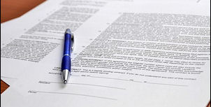
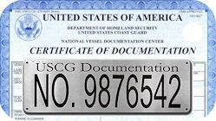
Plain Sailing
Qualifications for Vessel Registration

Slide 11
Qualifications for Registration – United States
Traditional Registry
  Strict and complex requirements
General Eligibility Requirements:
  At least 5 net tons
  U.S. built
  U.S. citizenship
  Not documented under the laws of a foreign country
Registration requirements include:
  Establishing ownership of the vessel by providing the Builder’s Certification, bill of sale, or title documentation;
  Proving ownership by U.S. citizen by completion of form CG-1258 (individuals and business entities); and
  Eligibility for the endorsement sought
    Registry, coastwise, fishery, and recreational

Slide 12
Qualifications for Registration – Canada
Must be a Canadian citizen or a permanent resident
A corporation/subsidiary of a corporation incorporated under the laws of Canada or a province (Note: New Brunswick does not have a residency requirement for directors.)
Ship management company incorporated under the laws of Canada or a province, acting with respect to all matters relating to the vessel
Unlike the U.S., there is no Canadian-built requirement

Slide 13
Qualifications for Registration - RMI
Vessel eligibility
  Vessels engaged in foreign trade
  Vessels under construction
Vessels should be under 20 years of age
  Waiver of Age may be granted
  Vessels 15+ years old must include additional documentation
Ownership through an RMI business entity
  Types of entities
  Process for entity formation
Vetting procedures
  Vessel physically vetted
  Vessel owner and operator are vetted regarding port State control record, casualties, pollution incidents, etc.
  All known parties are vetted through World-Check
Classification and statutory survey and certification requirements for commercial vessels and commercial yachts
  Surveys completed by Recognized Organizations (“Ros”) and compliance verifications for yachts completed by Appointment Representatives (“ARs”)
  Commercial vessels, including commercial yachts of 500 gross tons or more and passenger yachts, must be classed by a recognized Classification Society

Slide 14
Qualifications for Registration - Panama
Any individual or corporate entity may register a vessel under Panamanian flag
Corporations need not maintain a place of business in Panama
Corporate officers and directors need not maintain residency in Panama
No minimum tonnage requirement
Vessels over 20 years of age require special inspections
Panama allows dual registry

Slide 15
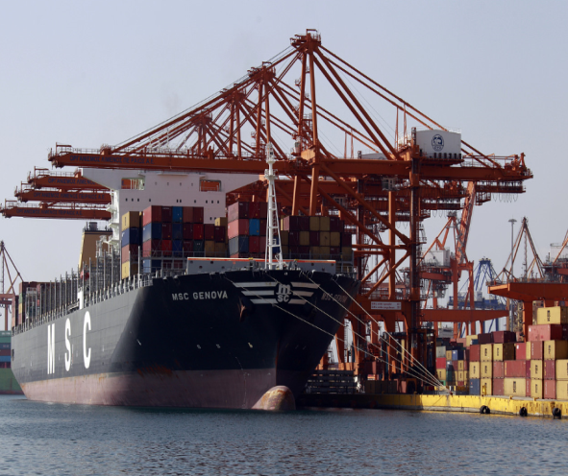
Qualifications for Registration – Mongolia
Submit Bill of Sale, existing registry and statutory certificates, and certificate of competency for all officers on board vessel
No restrictions on ownership of vessel (owner’s nationality/registration not taken into consideration) as long as applicant capable of owning vessel under laws of its national country
Completed within 24 hours

Slide 16

Get Underway
Registration Fees

Slide 17
Registration Fees – United States
Initial Certificate of Documentation: $133
Exchange Certificate of Documentation: $84
Return of Vessel to Documentation: $84
Replacement of Lost or Mutilated: $50
Approval of Exchange of COD requiring Mortgagee consent: $24
Late Renewal: $5
Trade Endorsements
  Coastwise: $29
  Coastwise Bowaters: $29
  Fishery: $12
  Registry: No fee required
  Recreational: No fee required

Slide 18
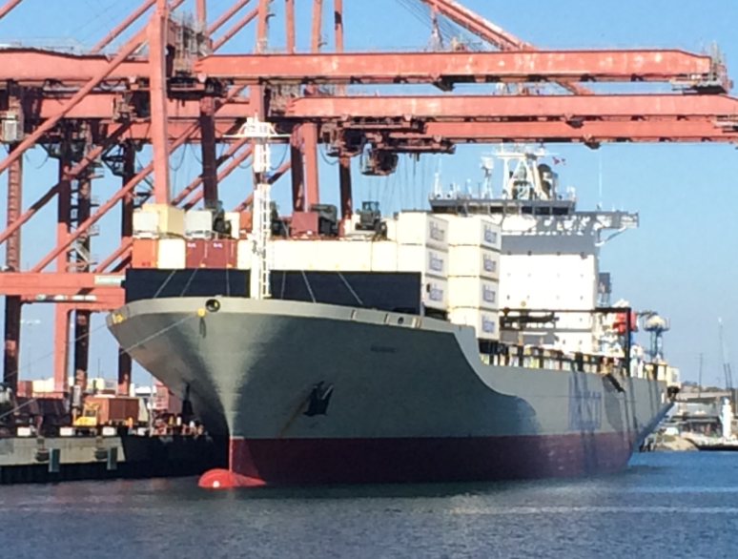
Registration Fees – Canada
Registration fee: $250
Registration applies to non-pleasure vessels powered by an engine of 10 hp or more

Slide 19
Registration Fees - RMI
Registration Fees
  Schedule A - Standard fees
  Schedule B – Sliding scale for various tonnage categories and a fleet discount
Tonnage tax calculator

Slide 20
Registration Fees - Panama
Registration fees in Panama are lower than many other registries
Approximately $0.25 per registered ton plus an additional $0.10 per net ton in annual tonnage tax
Owners may receive fee and tonnage tax discounts when registering a fleet of vessels

Slide 21
Registration Fees - Mongolia
“Low initial registration and annual tonnage taxes”
No cost to ship owners for setting up owning company

Slide 22

High and Dry
Taxation

Slide 23
Taxation – United States
The American Jobs Creation Act of 2004 created an “alternative tonnage tax” for income from the operation of certain U.S.-flag vessels in international trade (not domestic/Jones Act)
  Flat tax
  Based on vessel tonnage and number of days the vessel operated in the international trades
  If elected, the alternative tonnage tax is imposed in lieu of the normal corporate income tax with respect to the operation of the taxpayer’s “qualifying vessels”
Levels the playing field for U.S. Flag operators
  European countries were already allowing resident entities to elect a lower, alternative tonnage tax in lieu of income tax

Slide 24
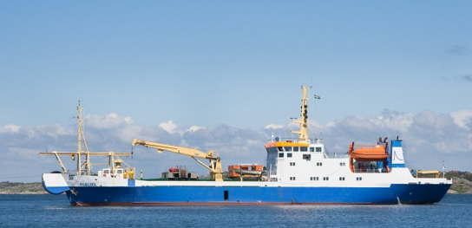
Taxation - Canada
Commercial marine activities undertaken in Canadian waters (i.e. Coasting Trade) are reserved to vessels registered in Canada on which all taxes under the Customs Tariff and Excise Tax Act have been paid
Canadian corporations subject to Income Tax Act

Slide 25
Taxation - RMI
Corporate
  Pursuant to section 12 of the RMI Business Corporations Act, all non-resident domestic business entities are exempt from taxes in the RMI
  Annual maintenance fee is due on the anniversary of existence
Tonnage taxes
  Due in fall on January 1 of a given year
    Schedule A
    Schedule B

Slide 26
Taxation - Panama
Panama does not collect income tax on profits resulting from the business made from merchant shipping outside of Panama
Shipping companies are not required to withhold income taxes from employees’ salaries if the vessel is on a coastal trade or performing work in the navigable waters of Panama

Slide 27
Taxation - Mongolia
Not much information on taxation
Low initial registration and annual tonnage taxes
No taxes on profits or capital gains

Slide 28
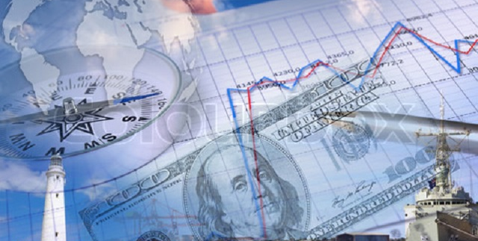
Between the Devil and the Deep Blue Sea
Vessel Mortgages and Liens

Slide 29
Mortgaging Vessels & Maritime Liens – United States
Mortgage recordation
  Any vessel documented under U.S. law can be the subject of a preferred mortgage
  Any individual/entity can be a U.S. vessel mortgagee
  The U.S. Coast Guard records vessel mortgages through its administration of the National Vessel Documentation Center (NVDC)
  Preferred mortgage has priority over all claims against a vessel except preferred maritime liens (wages, general average, salvage, maritime tort damages), expenses and costs allowed by a court
Preferred Mortgage Requirements :
  Signed by or on behalf of the vessel owner and acknowledged by a notary public;
  Addresses of the mortgagor and mortgagee;
  Cover the “whole” of the vessel, cite a definite amount, and identify the vessel name and official number/hull number;
  Filing and recording fee; and
  Valid Certificate of Documentation or an application on file and pending

Slide 30
Mortgaging Vessels & Maritime Liens - Canada
$150 fee to register or transfer marine mortgage
Registered vessels may have mortgages
Vessel Registration Query System to check if there is a mortgage on vessel
Mortgages considered high ranking liens, only superceded by traditional maritime liens such as crew wages, collision, salvage
Good security for lenders

Slide 31
Mortgaging Vessels & Maritime Liens - RMI
Mortgage recordation requirements
  Duly executed and with proof of due execution
  All recorded documents must be in English except:
    notices of foreign language ship mortgages and
    financing charters recorded pursuant to a bareboat charter
Content of mortgage
  Vessel name
  Hull number for a vessel under construction
  Names and identities of the parties to the mortgage
  Interest in the vessel affected
  Amount of the direct or contingent obligations that are or may be secured under its terms
Content of a Financing Charter
  Name and official number of the vessel
  Contract date
  Names and addresses of the documented owner and the finance charterer
  Amount secured by the financing charter
  Must be signed by the documented owner and charterer
Preferred mortgage
  “Tack on” option

Slide 32
Mortgaging Vessels & Maritime Liens - Panama
Preliminary registration of a title or mortgage is accepted by the U.S., Far Eastern, European, and worldwide banks as satisfactory security
A vessel mortgage may be executed in Panama or any other country, but must be registered at the Public Registry of Panama
Mortgages must include:
  Name;
  Address of parties;
  Fixed or maximum mortgaged principal;
  Amortization schedule of payments;
  Interest rate;
  Name of mortgaged vessel;
  Patent number; and
  Tonnage and dimensions.

Slide 33
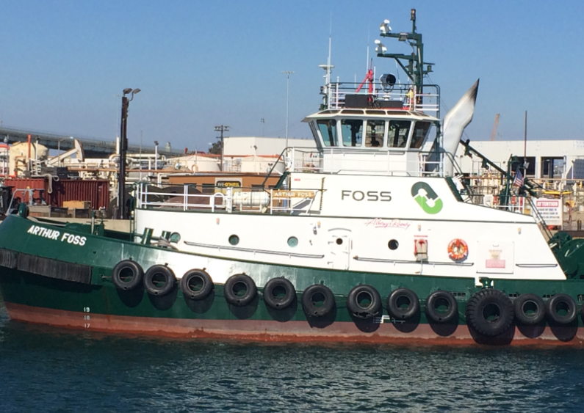
Mortgaging Vessels & Maritime Liens - Mongolia
Regulations for Registration of Ships in Ship Registry of Mongolia allows Mongolian vessel to be used as a security for a loan or other valuable consideration
Creditor/mortgagee prevented from acting on its security by detaining a vessel’s Certificate of Registry

Slide 34
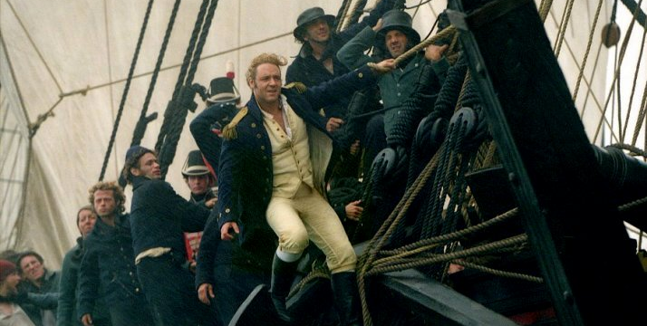
Anchors Away
Manning and Safety Requirements

Slide 35
Manning & Safety Requirements – United States
Seamen’s Act
Jones Act- Merchant Marine Act of 1920
  Was passed in an attempt to address seamen injured in the course of their duties, not previously covered by the Seamen’s Act
The USCG Marine Safety Manual, Volume III, Marine Industry Personnel, COMDTINST M16000.8B, provides information and interpretations on international conventions and U.S. statutory and regulatory issues relating to marine industry personnel
  Incorporates 2010 amendments to the International Convention on Standards of Training, Certification and Watchkeeping for Seafarers
46 CFR 15 provides the Coast Guard’s Shipping Manning Requirements for all vessels

Slide 36
Manning & Safety Requirements – Canada
Party to International Convention on Standards of Training, Certification and Watchkeeping for Seafarers, 1978 (minimum standards of competence required for seagoing personnel)
Transport Canada Marine Safety and Security issues Certificates of Competency to seafarers after they complete prerequisites and examinations
Five different service standards (i.e. Pleasure craft licensing, cargo inspection, marine personnel programs, navigable waters protection program, and vessel inspection and certification services)

Slide 37
Manning & Safety Requirements - RMI
All commercial vessels must hold a Minimum Safe Manning Certificate (MSMC) issued upon registration
  Sets forth the required minimum number of officers and crew in a specified grade
No nationality restrictions for vessel crew members
Certificate of Competence/Certificate of Endorsement (CoC/CoE)
  Equivalency endorsement
  Professional examination
Seafarer’s Identity and Record Book (SIRB)
  Special Qualification Certificates
  Continuous record of sea service

Slide 38
Manning & Safety Requirements - Panama
All vessels must pass an annual inspection that ensures that each vessel:
  meets international safety regulations;
  carries up to date certificates; and
  is properly manned and equipped for their intended trade.
Vessels built over 20 years ago must be inspected before receiving a permanent patent
Signatory to the International Convention on Standards of Training, Certification and Watchkeeping for Seafarers, 1978
Meets highest qualifications with regards to maritime safety standards

Slide 39
Manning & Safety Requirements - Mongolia
Required to have valid Mongolian certificate of endorsement (COE)
Duly licensed Master needs to be on board every registered Mongolian vessel
Vessels with propeller thrust > 300kw require licensed Chief Engineer on board
Every officer and crewman must have requisite training and certification pursuant to International Convention on Standards of Training, Certification and Watchkeeping for Seafarers 1978

Slide 40

Close Quarters
Labor and Operating Costs

Slide 41
Labor and Operating Costs – United States
MARAD study showed U.S.-Flag vessels’ operating costs were 2X higher than those for foreign-flag vessels
U.S. Labor laws generally apply, e.g., seamen working on U.S. vessels = subject to FLSA min. wage law, but not OT
Jones Act → maintenance and cure
The U.S. has not ratified the Maritime Labour Convention of 2006 (MLC)
In 2013 the U.S. Coast Guard published a notice in the Federal Register announcing availability of a draft Navigation and Vessel Inspection Circular (NVIC)
  Sets forth proposed Coast Guard policies and procedures regarding the inspection of U.S.-flag vessels for voluntary compliance with MLC 2006
  To assist U.S. vessels in avoiding port state control actions in foreign ports of countries that have become party to MLC 2006

Slide 42
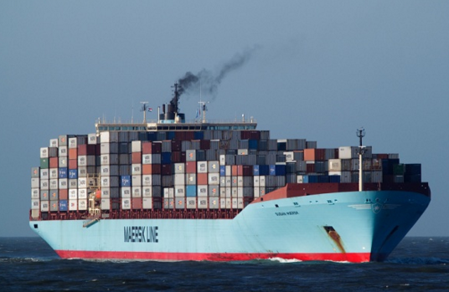
Labour and Operating Costs - Canada
Ratified Maritime Labour Convention of 2006 in June, 2010.
Specified branches of social security and the following benefits:
  Medical care;
  Sickness;
  Unemployment;
  Old-age;
  Employment injury;
  Family;
  Maternity;
  Invalidity; and
  survivor’s.

Slide 43
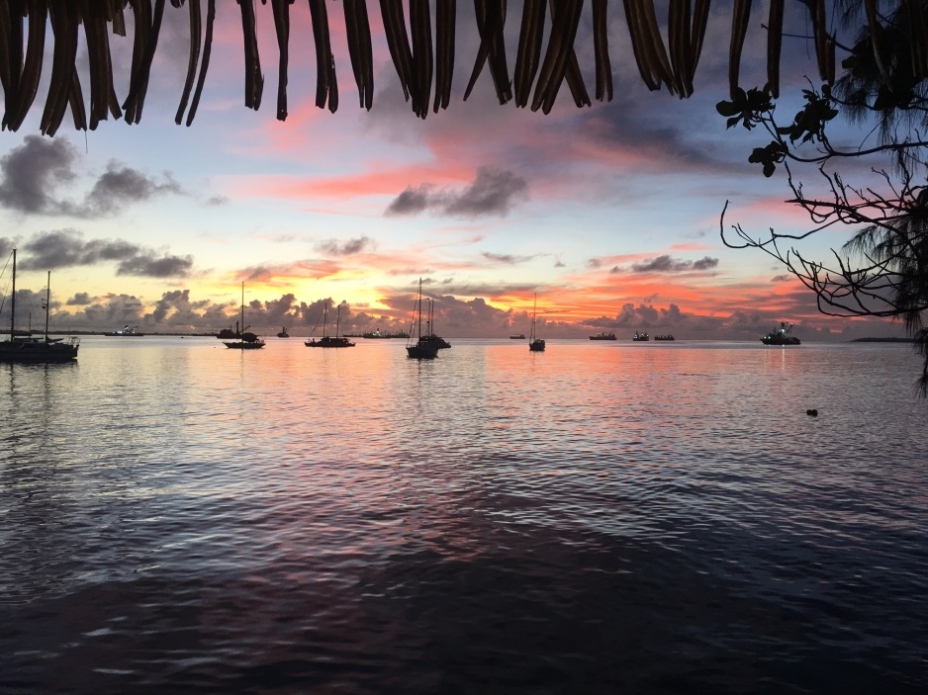
Labour and Operating Costs - RMI
Maritime Labour Convention of 2006
  Ratified 25 September 2007
  Voluntary program implemented in January 2010
  Voluntary program became mandatory in August 2013

Slide 44
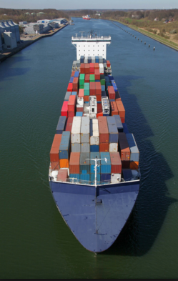
Labour and Operating Costs - Panama
Panama ratified the MLC of 2006 and the SSC 1952, accepting all obligations under the Convention concerning the following branches of social security:
  Old-age benefits;
  Invalidity benefits; and
  Survivors’ benefits.

Slide 45
Labour and Operating Costs - Mongolia
Has not ratified Maritime Labour Convention of 2006
Has not ratified Social Security (Minimum Standards) Convention of 1952
  As a result, subject to Port State Control inspections to enforce Labour Conventions’ minimum standards of work and living conditions
Has not accepted responsibility of ensuring safety and wellbeing of seafarers (e.g. Minimum wage, hours of work, wage payments, and medical care)

Slide 46
When the Ship Comes In:
Many key considerations to weigh in assisting vessel owners in determining where to register their vessel
  E.g., the convenience of quick registration under the flag of Mongolia can be balanced against the cost and labor requirements of the flags of Panama or the Marshall Islands
  These in turn may be balanced against the simplicity and efficiency of mortgage and lien registrations
In each case, the international reputation of the flag state, any port conveniences offered to a vessel flying certain flags, and labor requirements (or lack thereof), are balanced by the nationality of the purchaser (or not), and, perhaps, the age of the vessel

Slide 47

Questions?

Slide 48
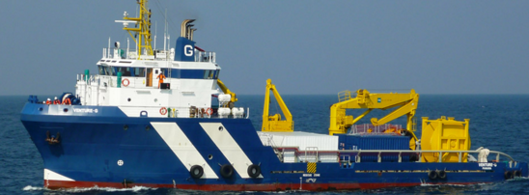
Thank you!
Sarah Gayer
  sgayer@thompsonbowie.com
  207-774-2500
Carrol Hand
  chand@Register-IRI.com
  703-620-4880 Ext. 1403
Bonnie Huen
  Bonnie@isaacsco.ca
  416-601-9784
Stephanie Penninger
  spenninger@beneschlaw.com
  317-685-6188

Slide 49
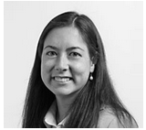
Sarah Gayer – Thompson & Bowie
Sarah is an associate at Thompson & Bowie, LLP where she practices admiralty and maritime law. She has experience in matters involving vessel arrest, maritime liens, tugboats and pilots, marina claims, Jones Act and unseaworthiness claims, pleasure and personal watercraft liability, Coast Guard investigations, marine construction, maritime property subrogation, vessel construction contracts and claims, and marine insurance. She graduated from Bowdoin College, cum laude, with a B.A. in Government and Legal Studies and Russian, and earned her J.D. from the University of Maine School of Law. She currently serves as Chair-Elect Designee to the American Bar Association TIPS Admiralty and Maritime Law Committee and previously served as a vice-chair to the committee. She is a member of the Maritime Law Association, Women’s International Shipping and Trading Association (WISTA), the Propeller Club of Portland, Maine, and the Edward Thaxter Gignoux Inn of Court.

Slide 50
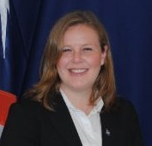
Carrol Hand - International Registries, Inc.
Carrol Hand joined International Registries, Inc. in August 2011 as Assistant General Counsel, and was promoted to Associate General Counsel in August 2014. She graduated from Barnard College with a Bachelor of Arts, from the University of Windsor with a Master of Science in Environmental Science, and earned a Juris Doctor (J.D.) magna cum laude from Tulane University Law School. At Tulane, Ms. Hand was a managing editor of the Tulane Maritime Law Journal and a board member of the Tulane Maritime Law Society. She is a member of the American Bar Association, the New York State Bar, the District of Columbia Bar, the Virginia State Bar (as Corporate Counsel), the Women’s International Shipping and Trading Association (WISTA), and the Maritime Law Association of the United States.

Slide 51

Bonnie Huen - Isaacs & Company
Bonnie Huen is a Toronto maritime lawyer and associate at the law firm, Isaacs & Company. Since being called to the Ontario bar in 2009, Bonnie’s focus has been on maritime and admiralty law. Bonnie represents all facets of the maritime industry which includes ship owners and their insurers, cargo owners and their insurers, participants in the ship supply industry, recreational marine insurers and marina operators. Bonnie has been involved in several admiralty trials, including Feuiltault Solution Systems Inc. v. Zurich Canada, a dispute regarding the interpretation of the insufficiency of packaging exclusion in an all-risks marine insurance policy, and J.D. Irving, Limited v. Siemens Canada Limited, the most recent limitation of liability trial in the Courts of Canada. Bonnie has been a director of WISTA Canada since December 2012. Bonnie is a member of the Marine Club, the Canadian Board of Marine Underwriters, the Canadian Maritime Law Association and the Canadian Transportation Lawyers Association.

Slide 52

Stephanie Penninger - Benesch
Stephanie Penninger is an associate in the firm’s Litigation and Transportation & Logistics Practice Groups and Chair of the firm’s Maritime Transportation Group. She focuses her practice on representing vessel and motor carriers, surface and ocean transportation intermediaries, national shippers, and water carriers in the domestic, non-contiguous trade lanes concerning transportation and logistics matters, including: providing counseling concerning maritime and admiralty law issues and regulatory compliance, handling maritime casualty matters, drafting ocean transportation service agreements and prosecuting and defending freight charge disputes and cargo claims for loss, damage or delay. Stephanie is the Diversity Vice-Chair of the American Bar Association, Tort Trial & Insurance Practice Section, Admiralty and Maritime Law Committee, and a member of the Maritime Law Association of the United States and the Transportation Lawyers Association.

