Slide 1
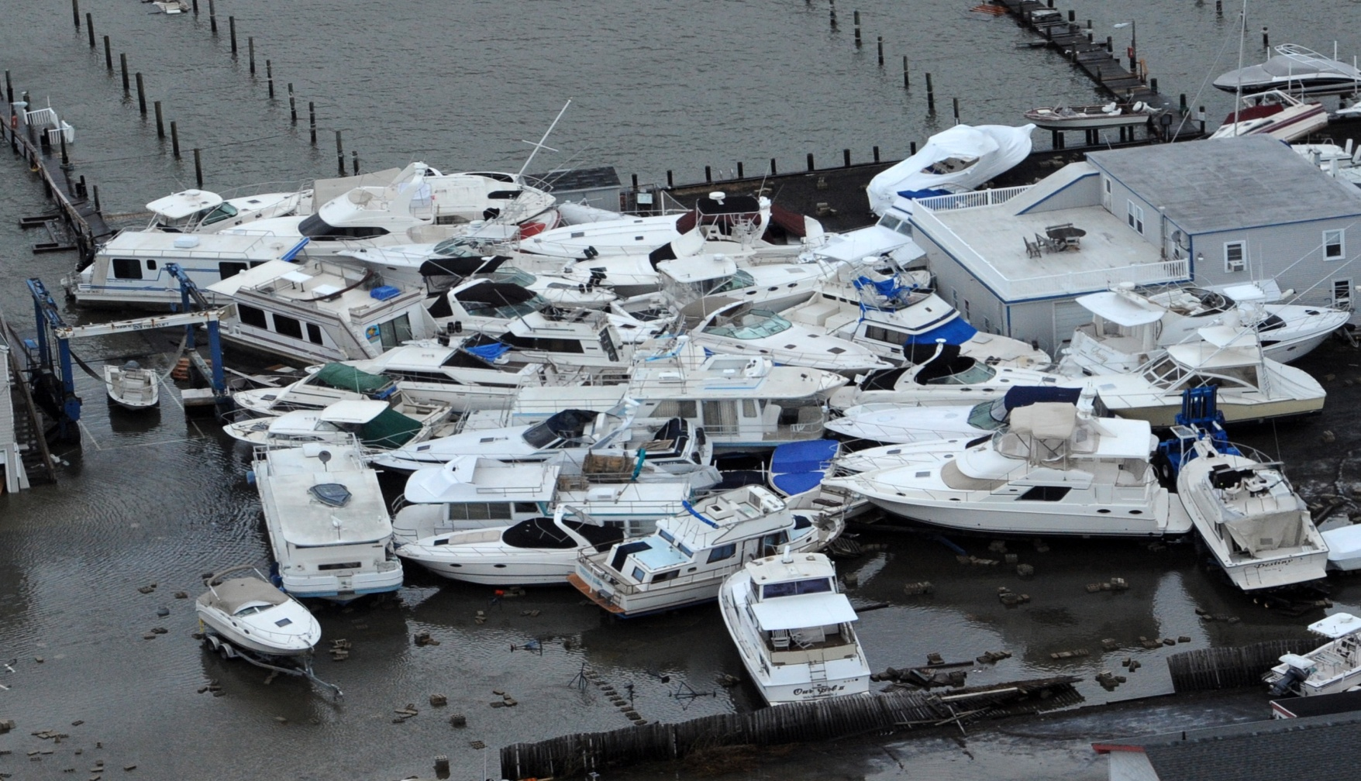
Maritime Law & the Marina Operator
Shelley Chapelski, Bull, Housser & Tupper LLP
Arie Odinocki, Isaacs & Co.
Canadian Maritime Law Association
June 7, 2013

Slide 2
Maritime Law & the Marina Operator
1. What are the Sources of a Marina's Legal "Rights"?
a. Oral and Signage (course of conduct) Contracts
Signage is a shield to protect the marina operations while a well written moorage agreement is a sword.

Slide 3
Sources of Marinas’ Liabilities
2. Marinas attract liability in relation to their activities on land and on water.
Water Activities [regulated federally as matters relating to navigation and shipping]
  Duty to provide safe berth
  Mooring and dry-docking
  Dredging and depth maintenance
  Navigation advice
  Debris and environmental management
  Whether preparedness (storms, tornados, floods)
  Boat rentals
On-Shore Activities [regulated provincially as matters relating to property and civil rights]
  Storage
  Maintenance and Repairs
  Other activities common to land businesses

Slide 4
Moorage Contracts: Exculpatory Clauses
Moorage contracts often contain limitation of liability/waiver clauses. A basic clause may read as follows:
Boats and engines are stored at owner’s sole risk and the marina accepts no liability for same, regardless of negligence. Boat owners are required to obtain their own insurance.
To determine whether the clause will be enforced, Courts look to:
  Language of the clause; and
  All facts relevant to formation of the contract.

Slide 5
Exculpatory Clauses (Continued)
Interpretation of the language of the clause:
  Interpreted strictly [what is the plain language meaning of the words?]
  Ambiguities interpreted against the interests of the marina [as party that drafted the clause and seeks to invoke it]
Facts relevant to formation of the contract:
  Is the clause clearly marked (print size and color)?
  Was the clause brought to the customer’s attention?
  Is there imbalance of power between the marina and the customer?
  Is the contract as a whole “unconscionable, unfair or unreasonable”?

Slide 6
Maritime Law & the Marina Operator
3. Federal Common Law and Provincial Statutory Law
Historical Background
Maritime matters (usually) solely within Federal law: shipping & navigation
Provinces have enacted remedies to make the economic affairs of their citizens easier to manage i.e. warehousing and repair lien legislation
But those laws do not apply to shipping & navigation

Slide 7
Personal Injury Claims
4. Injuries by and to boat renters, their guests and others
People who rent boats from marinas occasionally get injured or injure others.
Personal injury lawyers frequently sue marinas as “owners” of the vessels on the ground that they are ‘vicariously liable” for the negligence of the operators.
However, Canadian marine law does not extend “vicarious liability” to owners of vessels: Dixon v. Leggat.
No provisions equivalent to s. 192(2) of Highway Traffic Act in either Canada Shipping Act or Marine Liability Act.

Slide 8
Personal Injury Claims (Continued)
Marina can only be liable as owner if it was negligent:
  Negligent entrustment (to drunk or inexperienced boaters);
  Failure to properly instruct, inform or train the operator;
  Failure to follow its own policies on rentals;
  Failure to fill out the rental boat safety checklist; or
  Failure to check for Pleasure Card Operator Card

Slide 9
Maritime Law & the Marina Operator
5. General Marina Management Issues
Marina Policy Manual
moorage agreement must incorporate it by reference and it must be available to be easily reviewed by customers
Vessels under arrest at the marina
Get a court order that moorage while vessel is under arrest will rank as Sheriff’s costs and be a priority over other claims.
Parties will generally agree to a consent order because Courts invariably grant it.

Slide 10
Winterization and Storage
Damage/theft of boats stored at marinas
Marinas as bailees for reward have a legal duty to exercise the same standard of care and diligence toward the boats as reasonable and prudent owners would have.
However, bailee’s liability is not absolute:
  Marinas are not liable for accidental fires: Neff v. St. Catherines Marina
  Where cause of the fire is unknown or unexplained, there is no yardstick against which to measure the bailee’s conduct

Slide 11
Maritime Law & the Marina Operator
Getting Rid of Difficult Customers
Need a stick and a carrot. Explain that if person and boat leave by X date, and agree not to return without advance written permission, then marina will waive $XX of past due moorage
“Catch”
becomes a bailee – and liable to care for the boat as if it was the owner.
marina will have to pay the removal, storage and insurance costs until the debtor pays up (if ever).

Slide 12
Maritime Law & the Marina Operator
“Release”
The marina releases the mooring lines on the boat and lets it drift free.
marina will be liable for any damage
“Barbed Hooks”
mandatory injunction order from the Court to have the vessel removed by the vessel’s owner and sold or destroyed if the owner refuses to do so.
minimum of three months – more likely six to nine months or more
will cost $15,000 to $25,000++

Slide 13
Maritime Law & the Marina Operator
Court Eviction Order
Courts loathe to grant interlocutory mandatory injunctions over matters that just involve unpaid debts, even when the claim amounts to trespass by the boat owner over the premises of a privately owned marina.
Approach it from a safety aspect – what must the marina do to ensure that its customers are safe, that the environment is preserved and that the employees have a harassment free work place? Draft the affidavits in support of these objectives to make a compelling case for an interlocutory injunction.

Slide 14
Maritime Law & the Marina Operator
6. Collection Issues/Abandoned & Derelict Vessels
Why Does it Matter Whether a Vessel is Licensed or Registered?
The distinction related to how title to them can be transferred.
ownership to a registered vessel can only be changed by means of a) a signed Bill of Sale from the owner (or estate representative); b) a Bill of Sale signed by the mortgagee; or c) Court Order.
If a Bailiff purports to sell a registered vessel, he cannot transfer title to it. He has no right to sign the Bill of Sale and the ship’s registry is not supposed to accept it as evidence of transmission of the title to the vessel.

Slide 15
Maritime Law & the Marina Operator
With respect to licensed vessels, however, because there is no formal registry of ownership kept, such boats can arguably be sold by a creditor without a court order. I state "arguably" because there is no specific provision under Federal law to allow this. At the same time, there is no express impediment.
A Bailiff can sign a bill of sale to a licensed boat. The new owner can access government services and swear a statutory declaration that he has bought the boat. Service Canada will then likely issue the new owner a license for the boat in that owner’s name.

Slide 16
Maritime Law & the Marina Operator
Liability Exposure to Marinas
Exposure to damages could be:
(a) the fair market value of the boat (or the cost of repairs if the boat is just damaged and not sold or destroyed); and
any lost legitimate (and foreseeable) business opportunities.
If, boat has incurred considerable debt to a marina, marina has an independent surveyor backing up its low or worthless value and if it was sold, that the Bailiff got the best price possible, then the boat owner's damages should be zero.
Marina needs a good survey report and lots of photos/videos of the boat's poor condition. It is even better if the marina has log books recording how many times it has had to pump out the vessel or otherwise keep it from sinking or being damaged. The log would help prove the poor condition of the boat and the marinas efforts could constitute a claim for salvage services and increase the debt owed to the marina.

Slide 17
Maritime Law & the Marina Operator
7. Delinquent, Derelict & Abandoned Vessels Management Strategies
Offer to waive unpaid moorage if and only if the vessel leaves marina by certain date and agrees to not return.
If there are no mortgages on vessel, have owner sign a blank Bill of Sale in exchange for a waiver of moorage and sell "where is as is". Make sure that the new owner knows that the marina is not making any representations about title or debts against the vessel. Do not transfer the vessel into the marina’s name, as taxes would be payable and it would create potential liability to the marina for any pollution or liability caused by the vessel.

Slide 18
Maritime Law & the Marina Operator
Have vessel towed overland to and left on owner's property. Have it well surveyed first and take photographs before and after delivery. Remember the marina would be liable for any damage that occurs during the delivery because it becomes a bailee.
If the vessel is mortgaged, send a letter to the mortgagee. Get mortgage details from Ship's Registry (if a licensed vessel, check Personal Property Registry by "K" No. or HIN). The mortgagee may deal with unpaid moorage to avoid a fire sale of vessel or the owner may be embarrassed into dealing with the debt.
If the vessel is licensed (not registered) the Bailiff may be prepared to sell. The Bailiff generally cannot transfer title to a registered vessel without a Court Order. However, licensed vessels are often sold at Bailiff's sale without a Court Order. The marina can be sued for the loss of the vessel but hopefully the marina can prove that its value was less than the debt that was owing

Slide 19
Maritime Law & the Marina Operator
Arrest the vessel and seek a Court ordered removal or sale, or seek mandatory removal Order. However, this is costly ($15,000 to $25,000+++) and if the owner refuses to obey the Order, you are still left with cost of destruction. This method is only useful if there is decent value to vessel to recover the costs, let alone the debt.
If a vessel is arrested at your dock by another creditor, either get a Court Order that moorage from the date of the arrest ranks #1, along with the costs of arrest, or get the parties to agree to this.
Haul the vessel to the junkyard. It is absolutely critical to record its condition inside and outside and get a surveyor to confirm its lack of seaworthiness and value. The marina can be sued for the loss of the vessel but hopefully the marina can prove that its value was less than the debt that was owing.

Slide 20
Maritime Law & the Marina Operator
Consider seeking a Wreck Removal Order from Navigable Waters if the vessel has sunk and is an obstruction. However, this only works if the owner responds to the Order.
Report pollution or potential pollution to the CCG-ER, so they can order the owner to take remedial steps, and if it is sinking and polluting or in imminent danger of doing so, the CCG-ER may haul it off.

Slide 21
Maritime Law & the Marina Operator
Shelley Chapelski, Bull, Housser & Tupper LLP
Arie Odinocki, Isaacs & Co.
Canadian Maritime Law Association

