Slide 1
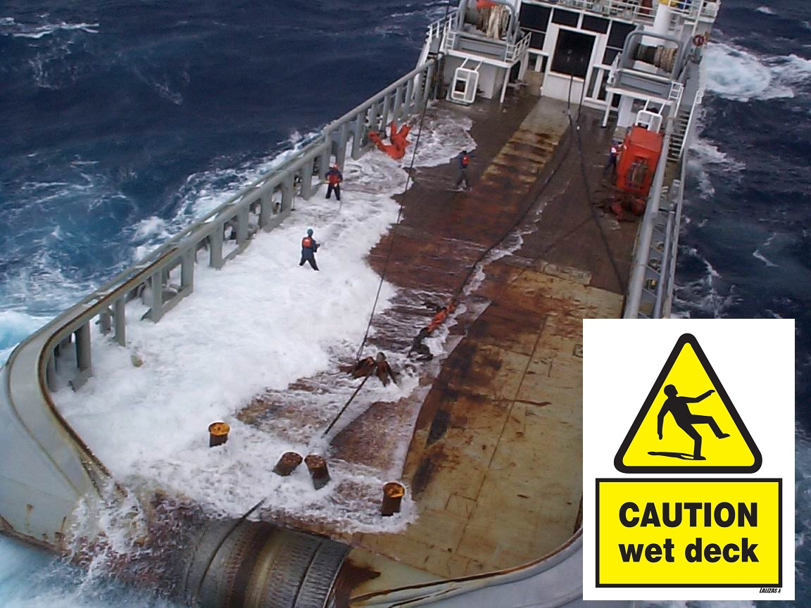
Slips and Falls on Board: What Can We Do to Reduce the Impact?
38th Annual CRUISE CANADA Conference of the Canadian Passenger Vessel Association, November 19 – 21, 2014

Slide 2
Isaacs & Co. Barristers & Solicitors Arie Odinocki & Bonnie Huen

Slide 3
Slip and Fall Statistics
Slip and falls are the leading cause of injury in Canada, second only to car accidents. According to Statistics Canada, slip and fall incidents represent 41% of preventable injuries in Canada with a total cost of over $3 billion annually [Ontario accounts for 35% of those numbers]
57% of all injury related hospitalizations in Ontario are due to unintentional falls
The dramatic rise in frequency of claims reported by the insurance industry since 1990 is a result of Americanization of our attitudes toward litigation
The increase in the number of claims and Court awards translates into increased insurance premiums for all businesses, even those who never had a claim
Ship owners/operators are not immune from this trend

Slide 4
Slip and Fall Accidents On Board
Risks particular to vessel owners/operators:
Wet decks, from washing down, rain/snow or sea “spray”;
Staircases;
Spilt food or drinks;
Failure to maintain deck surfaces; or
Improper building or construction materials for surfaces.

Slide 5
Liability of Vessel Operator
A shipowner is obliged to ensure that his vessel is “seaworthy” [fit and safe for use] and that it is navigated safely
Passengers are not expected to have maritime expertise but are expected to behave reasonably, be diligent and follow instructions
In the context of preventing slip and fall accidents, that means keeping the passenger areas well maintained, and ensuring that those areas are clear of debris or other hazards which may cause a passenger to slip and fall.

Slide 6
Legions of Lawyers Waiting for You To Take One “Mistep”

Slide 7
A Sample of Cases We Handled
Case #1
The plaintiff was wearing 3 inch high heeled shoes when she slipped on the main deck, on a rainy day.
The plaintiff was attending a “boat cruise” reception.
She did not notice anything on the floor that had caused her to slip. The deck was wet, although she did not see any puddles. She acknowledged the deck had a rough surface.
The vessel had just begun to leave the dock and was not stationary.

Slide 8
Sample of Cases Continued
Case #2
The plaintiff, bank teller, was participating in a skit as part of her company’s Christmas party on board a vessel when she slipped and fell on the dance floor while running across it.
The skit involved someone throwing play money in the air and the participants would scramble to retrieve it.
She had taken her boots off and was wearing nylon stockings at the time.

Slide 9
Case #2 – This is the TV commercial that the plaintiff and her co-workers were re-enacting:

Slide 10
Sample of Cases Continued
Case #2
The plaintiff had early onset advanced osteoporosis
When she fell on the dance floor, she fractured her hip, requiring three surgical procedures to repair the hip

Slide 11
Sample of Cases Continued
Case #3
The plaintiff and some of her friends drove their van onto a ferry. As the plaintiff was getting out of the car and stepping onto the ferry deck, she slipped and fell on the wet deck.
She admitted to having observed the deck being wet when they arrived. At discovery, she further admitted that she was wearing flip flops and had pre-existing mobility issues.
Friction co-efficient testing confirmed that the deck’s friction co-efficient was high, exceeding industry standards.

Slide 12
Contributory Negligence
In many slip and fall cases, there is a high degree of contributory negligence on the plaintiff
Nevertheless, plaintiffs and their counsel often ignore this fact and start claims on the expectation that the ship owner will “pay their way” out of the claim
Increasingly litigious society = ship owners should expect increase in number of claims

Slide 13
Other causes of slip and falls:
Inappropriate footwear
Dangerous or risky maneuvers
Inattention
Age related falls
Even fashion models are not
Immune…

Slide 14
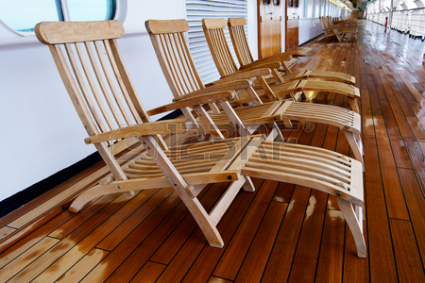
What Can A Vessel Operator Do to Minimize Exposure?
Reasonable System of Inspection
Choose the Right Materials
Regular Maintenance
Signage and Warnings

Slide 15
Legal Test Explained
Ship owners/operators obliged to ensure that vessel is “seaworthy”: Ordon Estate v. Grail (1996) S.C.C.
Provincial Occupiers’ Liability Acts do not apply aboard ships
However, principles of common law regarding occupiers’ liability do apply – hence, many cases decided in the context of Occupier Liability legislation will be followed in the marine context
STANDARD: Keeping passenger areas well maintained and ensuring passenger areas are clear of debris or other hazards which may cause a passenger to slip and fall

Slide 16
(a) Reasonable System of Inspection
Generally, an occupier will not be held liable for breach of its obligations if it adopted a reasonable system of inspection to ensure the safety of its premises.
McPhail v. T & L Club (Brantford) (1968): Plaintiff slipped and fell on a piece of cheese in a dance hall. The dance hall had a system in place to ensure that the dance floor was free of debris.

Slide 17
(a) Reasonable System of Inspection
The Ontario Court of Appeal stated that the occupier “is not an insurer”. The system in place was reasonable and an occupier’s duty “cannot be fixed at a level of constant inspection to thwart possible injury from bits of food… which might be dropped on the floor.”

Slide 18
(a) Reasonable System of Inspection
In Kerr v. Loblaws Inc. (2007), the plaintiff slipped and fell on a grape in a grocery store.
The Court of Appeal upheld the jury verdict that the grocery store had discharged its duty.
The store had a “sweep log” to document floor inspections and maintenance, and there were log entries before and after the accident.

Slide 19
(a) Reasonable System of Inspection
Lesson: Have reasonable policies and procedures in place for inspection, follow them, and document all inspection activities.
A reasonable system of inspection is the best defence against claims involving wet decks or spilt food or drink.

Slide 20
Reasonable Standard?

Slide 21
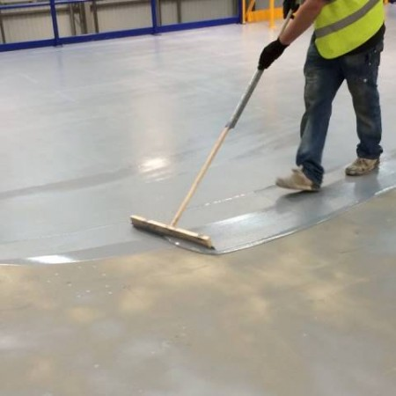
(b) Choose the Right Materials
Decks, stairs and other passenger areas should be constructed of slip resistant material.
Non slip coatings/paint
At least meet minimum industry standards

Slide 22
(b) Choose the Right Materials
Where a plaintiff alleges that a surface was “too slippery”, expert engineers can conduct co-efficient of friction testing on the surface to determine whether it met industry standards
If it did, then vessel operator likely can meet standard of reasonable care

Slide 23
(c) Regular Maintenance
Slip resistant areas must be maintained
Re-application of slip resistant coatings at regular intervals
Time between re-application depends on various factors
Exposure to elements
Foot traffic

Slide 24
(c) Regular Maintenance
Good practice to perform detailed check of adequacy of non-slip coatings at least once every year
This can be done as part of the annual safety inspection performed by Transport Canada

Slide 25
(d) Signage and Warnings
A vessel operator has no control over wind, rain or other conditions, such as rough seas, causing water to accumulate on deck

Slide 26
(d) Signage and Warnings

Slide 27
(d) Signage and Warnings
Visible, well-placed signs such as “DECKS SLIPPERY WHEN WET” or “USE HANDRAILS AT ALL TIMES” are simple and effective
The lack of signage does not mean that a vessel operator breached its duty
However, presence of warning signs can preclude a plaintiff from arguing that they were not aware, for example, that the deck is slippery when it is wet

Slide 28
Summary
Courts recognize that the duty of care of an occupier is one of reasonableness, not perfection. The same applies to vessel owners and operators.
A vessel operator does not need to remove every possible danger.
An occupier is not an insurer.

Slide 29
Summary
Unfortunately, individuals are quick to assign blame. Often, there is an insurer behind the occupier/vessel operator and plaintiffs and their lawyers conflate the two.
This means that where a slip and fall happens, you may be sued notwithstanding that you have done nothing wrong.

Slide 30
Plaintiffs Don’t Have This Penguin’s Attitude:

Slide 31
Strategies to Preserve Evidence
Prepare an incident report
Find out from the injured person, in their own words, what happened
Document the injuries
Document the location
Note the weather conditions prior to and at the time of the accident

Slide 32
Strategies for Preserving Evidence
Take photographs of the deck surface or area where the accident occurred
Take statements from any independent witnesses or employees
Make note of (and photograph) the injured person’s footwear, the condition of the footwear and the soles

Slide 33
Strategies for Preserving Evidence
If the fall occurs in a wet area or liquid is involved, determine the source of the liquid before cleaning it up
Alert your broker or lawyer before making any changes to the area where the fall occurred
Make sure to keep your records: plaintiffs have two years to commence a claim.

Slide 34
Thank you
Arie Odinocki & Bonnie Huen
arie@isaacsco.ca / bonnie@isaacsco.ca

