Slide 1
DRONING ON … FOLLOWING THE RULES AND FUTURE FUN
Heather C. Devine and Michelle L. Staples
Isaacs & Company
Toronto, Ontario

Slide 2
Notes:
https://www.youtube.com/watch?v=FY5U7eySew4

Slide 3
RULES AND PENALTIES
Canadian Aviation Regulations s. 602.41
No person shall operate an unmanned air vehicle in flight except in accordance with a special flight operations certificate or an air operator certificate
If it is found that a commercial drone was deployed without an SFOC, detailed information shall be passed on to the Regional Enforcement branch for action and fines may be enforced
Section 602.41 of the Canadian Aviation Regulations provides for maximum monetary penalties:
Individuals - $5,000
Corporations -$25,000
Notes:
Higher than 90m above the ground
At least 30m away from vehicles, vessels and the public (drones over 250g and up to 1kg)
At least 76m away from vehicles, vessels and the public (drones over 1kg and up to 35kg)
At least 5.6km away from aerodromes
At least 1.9km away from heliports or aerodromes exclusively used by helicopters
Outside of controlled or restricted airspace
At least 9km away from a natural hazard or disaster area
Away from areas where its use could interfere with police or first responders
To be used during the day and not in clouds
Always within the eye sight of a user
Within 500 m of a user
Only of clearly marked with user name, address and telephone number

Slide 4
DOES MY DRONE NEED SPECIAL PERMISSION?
In the following circumstances, drone users are required to obtain a SPECIAL FLIGHT OPERATIONS CERTIFICATE:
Drones weighing over 35kg
Flying a drone for work purposes
Flying a drone for research purposes
Notes:
By submitting detailed information about the parameters of the flight including the purpose and a detailed contingency plan to demonstrate that safety have been mitigated, on a case-by-case basis, after approximately 20 working days, the Minister of Transportation will grant an SFOC
However – an applicant will not be granted long-term authority or an authority that is not site-specific without a history of demonstrating safe operations.
Transport Canada suggests that once an SFOC has been issues, subsequent applications by the same applicant could be expedited, however initially, Transport Canada wil require a full SFOC application for each use.
Over time, demonstrated success could potentially lead to granting longer periods of authority as long as Transport Canada receives in informal notice of the flight at least two days before each specific operation

Slide 5
DOES MY DRONE NEED SPECIAL PERMISSION?
Notes:
Getting permission to fly your drone: the Transport Canada Website has a very simple questionnaire to inform individuals if they require a special flight operations certificate
Link to Transport Canada questions about obtaining special permissions: https://www.tc.gc.ca/en/services/aviation/drone-safety/getting-permission-fly-drone.html
Link on qualifying for exemptions if you would like to review: https://www.tc.gc.ca/en/services/aviation/drone-safety/getting-permission-fly-drone/qualifying-exemption-fly-drone.html

Slide 6
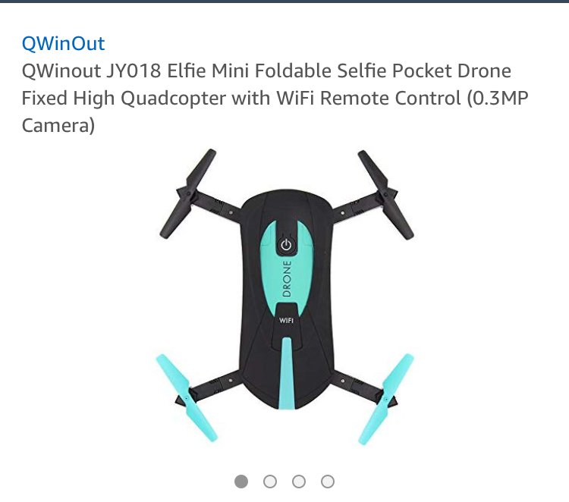
DRONES FOR FUN
Foldable
Fits in your pocket
$45 CAD

Slide 7
COMMERCIAL DRONES

Slide 8
COMMERCIAL DRONES – HOW CAN THEY HELP ME?
Inbound logistics
Carrying materials from storage to factory
Transporting directly from receiving to shipping
Reducing labour costs
Drones can have an extremely practical purpose when utilized in the commercial setting, including task such as:
Mapping
Crop monitoring
Scanning Inventory
Tracking trailers
Tracking cargo containers
Notes:
Using autonomous robots to drive supply chain innovation – Deloitte

Slide 9
HOW CAN DRONES HELP ME?
Inventory management and cycle counting done by drones can support more accurate supply-demand reconciliation and replenishment need, ultimately reducing on-hand inventory. Robotic process automation can benefit data entry tasks performed in demand and supply planning
Notes:
Using autonomous robots to drive supply chain innovation – Deloitte

Slide 10
LEGAL AND SAFETY
Not equipped with transponders
Pre-programmed flights have no regard for objects in flightpath
Harmful if dropped from sky
Serious danger if interference with aircraft occurs
Privacy issues

Slide 11
LEGAL CASES: USA EXAMPLES
PRIVACY
Drone users accused of invasion of privacy
Felon eavesdropping in the US
Attempted unlawful surveillance
CRASHES
Injuring people
Damaging property
Have led to charges and jail time and community service
Notes:
Drones at Home
Drone Incidents: A survey of Legal Cases
April 2017
Arthur Holland and Michel and Dan Gettinger

Slide 12
LEGAL CASES: USA EXAMPLES
DRONE USE
Flying in restricted areas
Flying without permits
Not adhering to regulations
CLOSE ENCOUNTERS WITH MANNED AIRCRAFT
High risk around airports
Refusing to land drone at scene of accident
Impeding first repsonders
Notes:
Drones at Home
Drone Incidents: A survey of Legal Cases
April 2017
Arthur Holland and Michel and Dan Gettinger

Slide 13
LEGAL CASES: USA EXAMPLES
SMUGGLING
Cross-border smuggling
Contraband drops in prisons
SHOOT DOWNS
Aerial trespass
Challenges for drone operators and gun owners
Notes:
Drones at Home
Drone Incidents: A survey of Legal Cases
April 2017
Arthur Holland and Michel and Dan Gettinger

Slide 14
AIR HIGHWAYS
Notes:
https://www.youtube.com/watch?v=rj3aUPSiolQ

Slide 15
THE FUTURE: AIR HIGHWAYS
DSA: Detect, Sense-And-Avoid Systems
Ability for unmanned aircraft to perform collision avoidance
Still a future goal
Creating air highways seems to be the most logical path forward in dealing with safely integrating drone operation with the manned aircraft and other airborne or tall structures
Notes:
Integration of UAV’s/Drones into national airspace appears to be the ultimate goal of both Transport Canada and the FAA. Recently both Canada and the US have pinpointed the ability for unmanned aircraft to perform collision avoidance through DSA’s
This critical capability must further be developed in order to enable comprehensive integration of DSA into drone regulation
Transport Canada currently seeks to create right of way rules for drones and if pilot interaction is required, transmission and decision time must also be included in the total time between initial detection of a potential collision and the point of minimum separation between drone and object.
The availability of reliable DSA technology is a future goal; until them, finding ways to safely integrate drone operation with the manned aircraft and other airborne or tall structures via air highway systems seems to e the most logical path forward

Slide 16
CANADA’S FUTURE: DRONE DELIVERY CANADA
DDC is a pioneering technology firm based out of Toronto
Strong focus on designing, developing and implementing a commercially viable drone delivery system within Canada
Launching commercial pilot programs in remote communities in northern Ontario
Hoping to solve infrastructure issues facing many isolated and rural communities in northern Canada
Has completed flights up to 2.12 kms
Notes:
Corporate profile on DDC website states Toronto – office is in Vaughan
Website: http://www.dronedeliverycanada.com/company-profile/

Slide 17
WHAT’S NEXT?
Chris Sultemier, former executive VP of logistics for Walmart joined the board of warehouse drone pioneer PINC
“I’ve seen first hand how large organizations can benefit from PINC’s
solutions, especially the aerial inventory robots.”
Boeing has built a drone that can carry 500lbs of cargo
Notes:
Christ Sultemier Quote: Move over Delivery drones, warehouse drones are ready for the spotlight. Supply Chain Drive. August 28, 2018 by Gary Wollenhaupt
Boeing: https://www.theverge.com/2018/1/10/16875382/boeing-drone-evtol-cav-500-pounds

Slide 18
Notes:
https://www.youtube.com/watch?v=LQI5LCMURno

