Slide 1
DRONES AND THE FUTURE OF FREIGHT
Heather C. Devine and Michelle L. Staples
Isaacs & Co.
416.601.0610
heather@isaacsco.ca

Slide 2
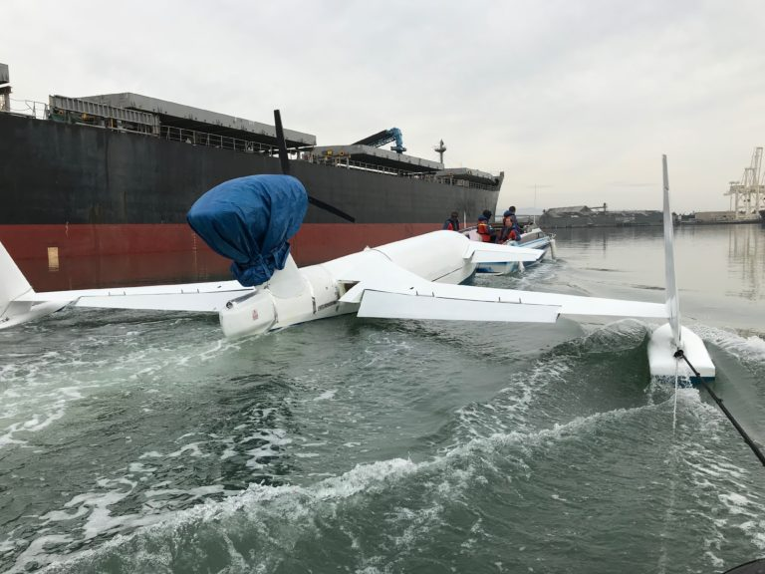
Drones and Freight Forwarders
Natilus is a California based start-up hoping to change the future of international cargo transport

Slide 3
Natilus and the Nemo
Drone designed to take off and land in water
Prototype can carry up to 700lbs of cargo a distance of 2,500 nautical miles
Successfully completed medium-speed taxi testing
Goal of carrying up to 200,000 lbs
Plans to sell directly to companies like FedEx and UPS as well as medium freight forwarders like Whole Foods and Costco
Notes:
In May of 2018 Taxi testing was being conducted in California’s San Pablo bay, northeast of downtown San Francisco
The team has solidified the hydrodynamics and ground control station operations
https://aircargoworld.com/allposts/drone-maker-natilus-completes-prototype-taxi-tests-releases-images/
https://www.fastcompany.com/3069053/a-startups-plan-to-halve-cargo-shipping-costs-with-777-size-drones

Slide 4
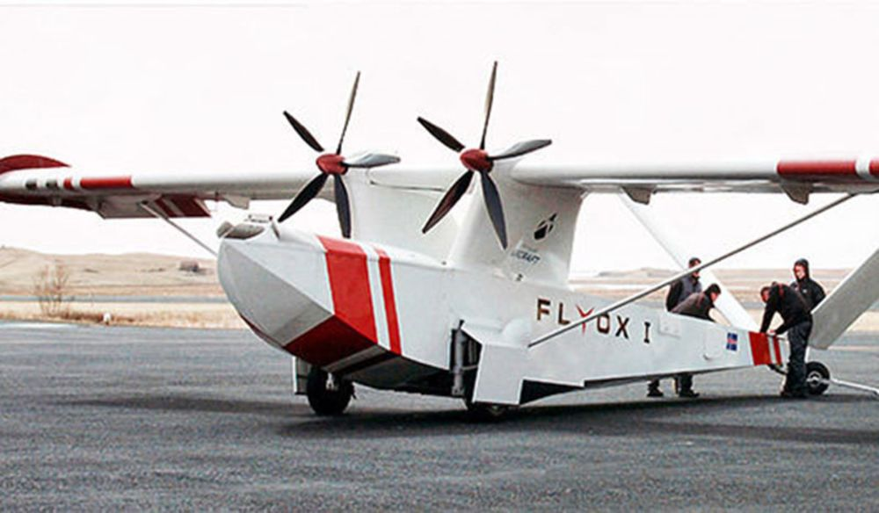
Drones and Freight Forwarders
Singular Aircraft is a Spanish company that developed the FLYOX I
4 Main Purposes
  Cargo
  Agriculture
  Firefighting
  Surveillance
Notes:
Unveiled in 2-14 and first flight was completed in May 2015 in Hofn, Iceland
https://www.aerospace-technology.com/projects/flyox-i-amphibious-uav/

Slide 5
FLYOX I and Cargo
  Can carry 1,850 kgs of payload
  Amphibious
  Can land on ice, snow and unprepared surfaces
  Variant is 40% more economical and 15 times faster than land transport
  Remotely piloted up to a line of sight range of 120km
Notes:
https://www.cnbc.com/2018/05/11/drones-could-have-a-big-role-to-play-in-the-future-of-freight-transport.html
https://www.aerospace-technology.com/projects/flyox-i-amphibious-uav/

Slide 6
Key Points
Amphibious is the way to go
Implementation challenges/airspace issues
Best places to first implement:
  Remote locations
  Areas where overland travel is dangerous/impossible
  Areas with poor existing land infrastructure
Notes:
https://www.cnbc.com/2018/05/11/drones-could-have-a-big-role-to-play-in-the-future-of-freight-transport.html

Slide 7
Managing a Drone Fleet in your Warehouse
Drones are the future of inventory management
Drones help to cut down losses resulting from lost items
Drones can cut down on operational costs
Notes:
Businesses can adopt print apply labelers that are compatible with barcodes and images on items stored in warehouses. MIT has successfully developed am ethod that allows them to use the drones as the relaying channel which lets businesses to adopt the use of tracking warehouse stock inventories without adopting ne RFID tags, software and tag readers: https://datafloq.com/read/how-mit-researchers-drone-fleets-track-warehouse/3819
https://www.m-h-e.com/are-drones-the-future-of-warehouse-operations/

Slide 8
RFID Scanned Items
MIT has been testing RFID scanners
Can read RFID tags from tens of meters away
Average error of 19 centimeters
Drones relay signals emitted by a standard RFID reader

Slide 9
Drone Management Systems
Several companies are now offering drone fleet management systems
Like operating a fleet of vehicles, drones require logistical, safety and regulatory oversight
Notes:
https://www.verizonconnect.com/resources/article/drone-fleet-management/

Slide 10
Drone Management Systems
Verizon
  Helps companies launch and run safe, efficient drone operations.
DJI Drone Management
  Aimed at providing a cohesive management system for corporate clients eager to safely and effectively manage their drone fleets
Notes:
Verizon: https://www.verizonconnect.com/resources/article/drone-fleet-management/
DJI: http://www.thedrive.com/aerial/15891/djis-launches-flighthub-a-drone-fleet-management-system

Slide 11
Drone Management Systems
FlytBase
  Designed to offer enterprise-grade security and deployment options to suit a wide range of requirements
RMUS Drone Management
  Helps get your drones off the ground with customized packages to fit specific needs and a “train the trainer” program
Notes:
FlytBase: https://flytbase.com/warehouse-management/
RMUS: https://www.rmus.com/collections/enterprise-alliance-program?gclid=CjwKCAjwo_HdBRBjEiwAiPPXpFnUiwYZ_5Z3wZuHgFFApi9Gmzdo0K2FLPfx-hzIgZkL_WlI4td7zhoCULkQAvD_BwE

Slide 12
Drone Insurance
Drone Insurance can cover more than just injuries
  Damage to or loss of the drone
  Ground station equipment issues
  Drone-mounted services (like cameras)
  Liability to 3rd party property
  Liability for bodily injury
  Business protection
Notes:
https://petleyhare.com/ontario-drone-insurance-services/

Slide 13
Why Insure My Drone?
Transport Canada mandates drone insurance
Makes your business more attractive to potential clients
Provides peace of mind to clients
Provides peace of mind to YOU!
Notes:
https://petleyhare.com/ontario-drone-insurance-services/

Slide 14
Companies Offering Drone Insurance
Petley-Hare Limited
CoverDrone
Zurich Canada
Intact Insurance
Notes:
Just a few I found:
Petley-Hare: https://petleyhare.com/ontario-drone-insurance-services/
CoverDrone: https://www.coverdrone.com/drone-insurance-canada/#close_newsletter
Zurich Canada: https://www.zurichcanada.com/en-ca/prodsols/drones
Intact: https://www.intact.ca/nu/en/business-insurance/business-liability/commercial-drone.html
Intact:

Slide 15
Risk Management
Safety First Approach
Educate Employees
Leverage Tools for Checking Airspace
Reduce Risk with Flight Automation
Pre- and Post-Flight Check Lists
Develop Emergency Procedures
System of Record: Tracking Pilots, Flight Logs and Missions
Notes:
https://blog.dronedeploy.com/7-ways-to-manage-risk-in-your-drone-operation-45580b2c8b6a
Safety First: Establish protocols to reduce risk! When things go wrong it can damage a company’s reputation, cost them business, increase operating costs and slows a company’s ability to grow.
Educate Employees: If employees don’t understand what the risks are there will be less incentive to stick with guidelines and safety measures in place
Leverage tools for checking airspace: check your airspace before flying – temporary flight restrictions can change at any time and it is important to always be compliant with Transport Canada/FAA regulations at all times. Fleet management software as discussed earlier can help with these issues
Reduce risk with flight automation: drone flight can be challenging and there are often tons of obstacles ranging from structures to weather. When you automate drone flights it helps reduce the risk of something going wrong – like a collision. Automation allows you to set flight parameters like speed and altitude
Pre and post flight checklists: This helps reduce risks. Effective checklists are often simple. Repeatable and will address the mission, jobsite, flight crew and environment.
Emergency Procedures: even when trying to minimize risk, incidents can still occur. Having an emergency plan in place increases chances of employees efficiently responding without forgetting any important steps
System of record for tracking pilots, flight logs and missions: records are critical should something go wrong during or after a mission. Tracking systems will help should any legal issues arise.

